Slide 1
Python web blocker

Slide 2
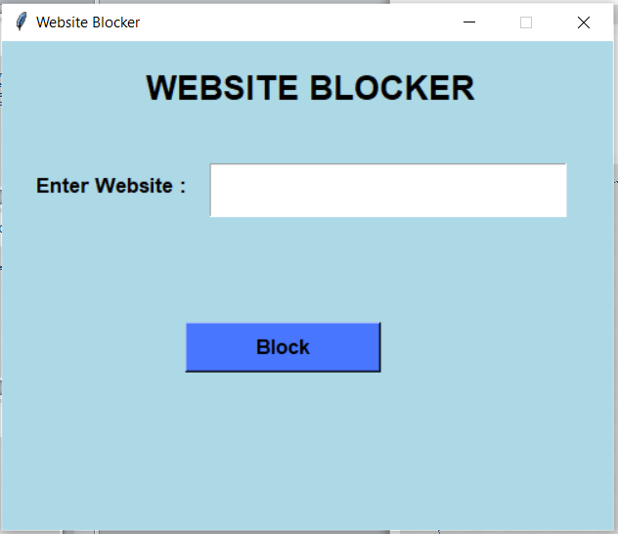
Website Blocker is a tool that denies access to websites permanently or by schedule. To use the internet safely we can block all websites from unwanted categories.

Slide 3
objective
This project will help the user to stay away from their distraction by blocking websites from their device so that they can not open them.
In this Python Website Blocker Project, the user can enter multiple websites to block, and then clicking on the block button will check the condition that if the website already blocked then print ‘already blocked’ else blocked all that websites and print ‘blocked’.

Slide 4

Project Prerequisites
To implement website blocker project, we will use the basic concepts of Python and Tkinter library.
Tkinter is a standard GUI Python library. It is one of the fastest and easiest ways to build GUI applications using Tkinter.
To install the library, you can use pip install command to the command prompt:

Slide 5
Steps to build Website blocker Python Project
Importing the module
Create the display window
Create an entry widget
Define function
Create a block button

Slide 6
Create the display window
Tk()
geometry()
resizable(0,0)
title()
Label()
font
root – name which we refer to our window
text – which we display on the label
pack – organized widget in block

Slide 7
File Handling
data is small then this processing can be done every time you run the script but in case of humongous data repetitive processing cannot be performed, hence the processed data needs to be stored. This is where data storage or writing to a file comes in.

Slide 8

Open a File in Python
Reading and writing file:
We use open () function in Python to open a file in read or write mode.
open ( ) will return a file object.
Syntax:

Slide 9
Access Modes.
There are Six kinds of mode:
Read Only (‘r’)
Read and Write (‘r+’)
Write Only (‘w’)
Write and Read (‘w+’)
Append Only (‘a’)
Append and Read (‘a+’)

Slide 10
Project overview
When the user enter the URL.
(i.e www.facebook.com) and on click the block button user blocks the url.

Slide 11
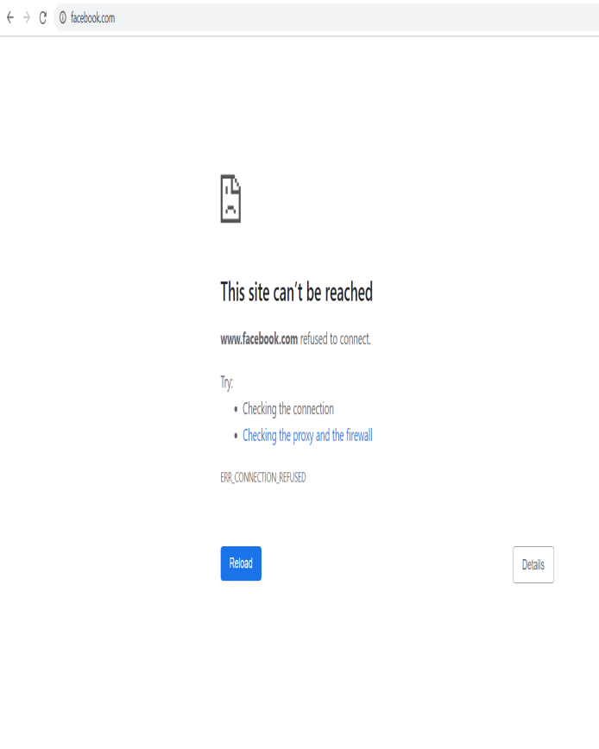
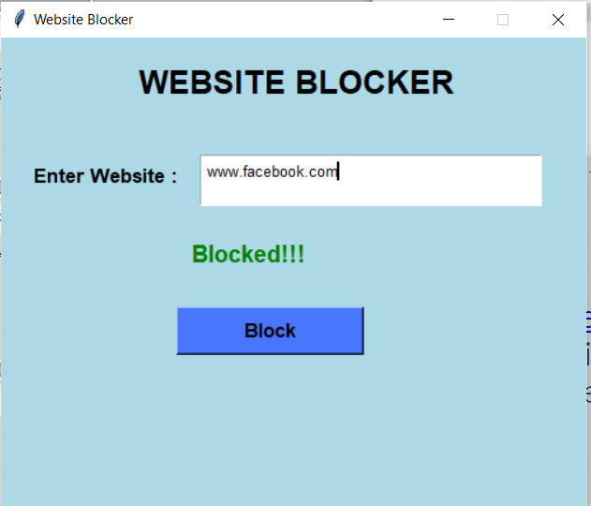
working

Slide 12
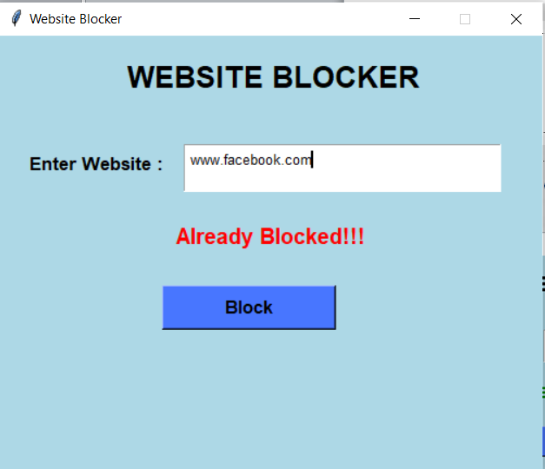
working
User will not allowed to block already blocked sites.

